Slide 1
DA Project 1 - Water System
Class 17, Group 5

Slide 2
Introduction
This project consists of a simplified simulation of a real-life water network
The water originates from the various reservoirs, travels through pipes and stations until arriving at its final destination, the cities
In order to simulate said system, we implemented a graph, which will soon be described
Group members: Duarte Assunção up202208319 33.(3)% Pedro Gorobey up202210292 33.(3)% Lucas Bessa up202208396 33.(3)%

Slide 3
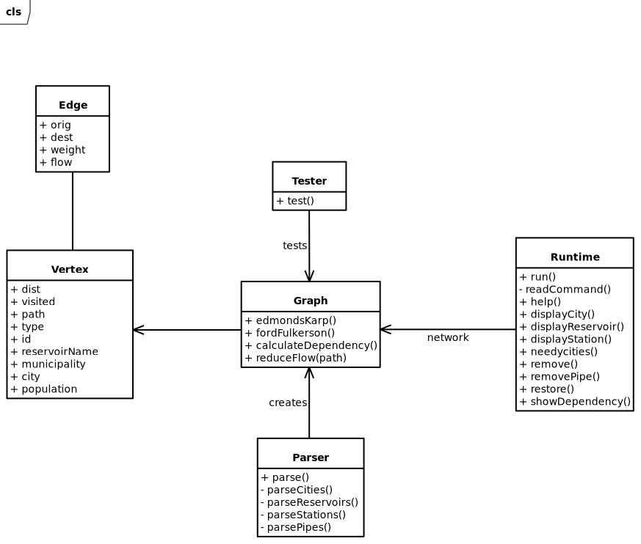
How the Graph Works
The Graph is a very basic one, consisting of nodes (vertexes) connected by directed weighted edges
In the diagram class, each class is in the files with the same name, one ending with .cpp and the other with .hpp

Slide 4
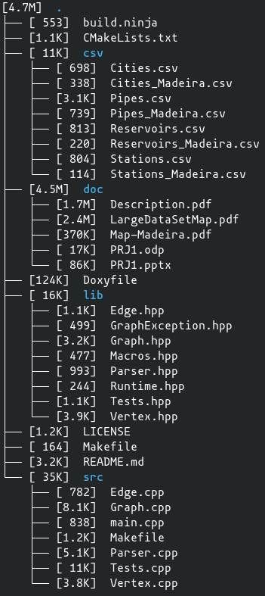
File Structure
csv/ - CSV files with Graph data
doc/ - Documentation folder
lib/ - Header files
src/ - Source files
build.ninja - Compilation file
CMakeLists.txt - Compilation file
Doxyfile - Documentation file
LICENSE - The Unlicense
Makefile - Compilation file
README.md - Project description

Slide 5
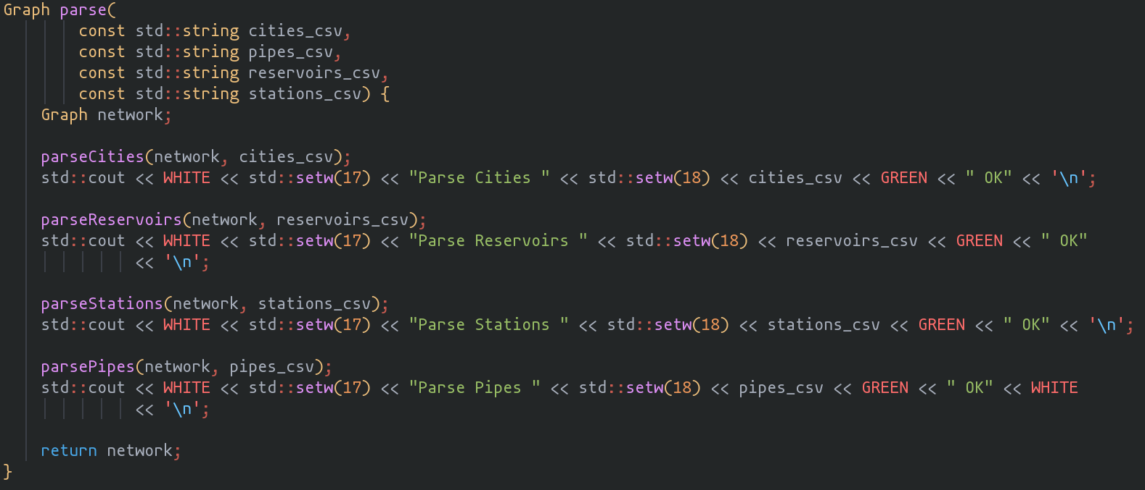
Parsing (1/2)
This function is called on the main.cpp

Slide 6
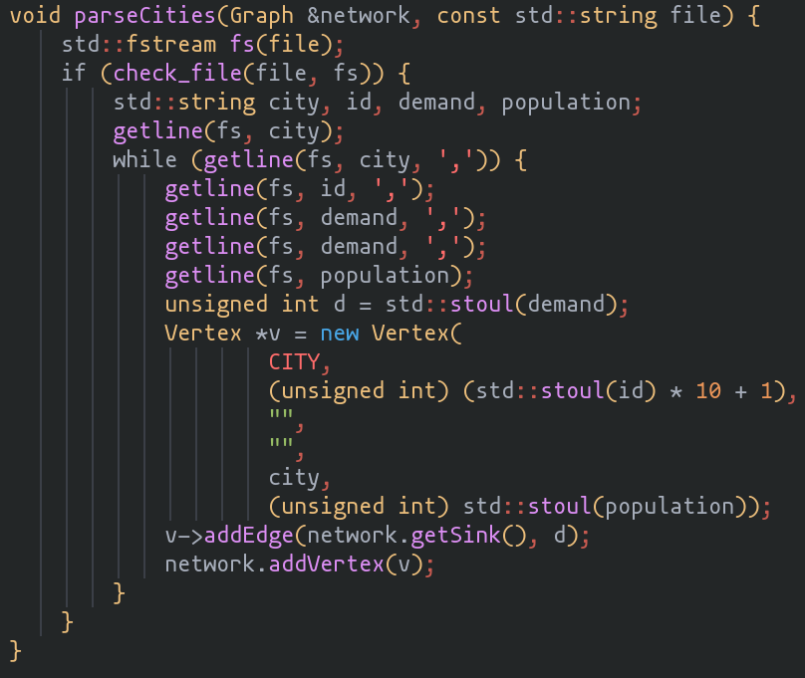
Parsing (2/2)
This fetches the data from the respective CSV file and stores it in temporary variables used to create the Vertex
The code is ignored
The other functions (parsePipes, parseStations and parseReservoirs) are very similar to this one

Slide 7
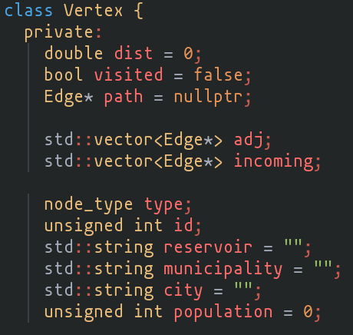
Vertex
Serves as a station, reservoir or city (only one at a time)
Used as pointers throughout the project
Methods consist of getters, setters and addition/removal of Edges
Because we wanted each Vertex to have a unique id, we actually store in the Vertex an altered id depending on the type. The last digit is different: 1 for Cities, 2 for Reservoirs and 3 for Pumping Stations. Wen we want their actual id, we use the method getTypeId() that extracts this last digit

Slide 8
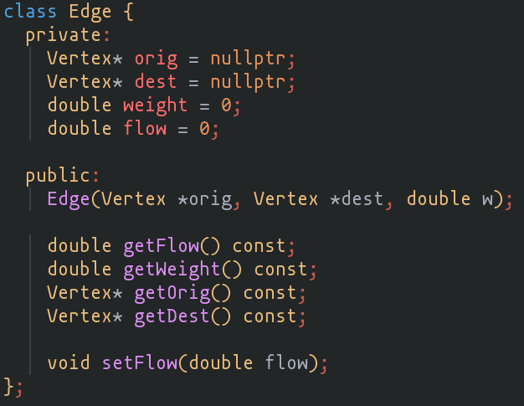
Edge
Serves as pipes connecting stations, cities and reservoirs
The “weight” is the capacity of the pipe
Also used as pointers

Slide 9
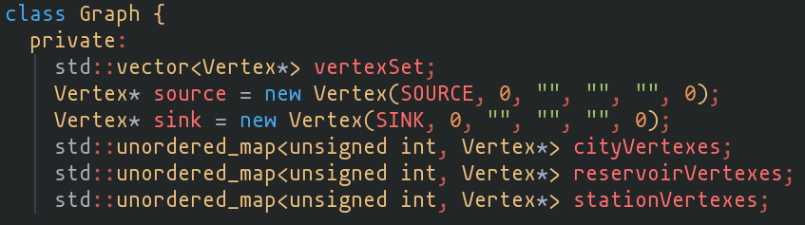
Graph (1/3)
Simulated water network
The unordered maps are useful to find certain vertexes
The methods range from getters/setters to max-flow algorithms

Slide 10
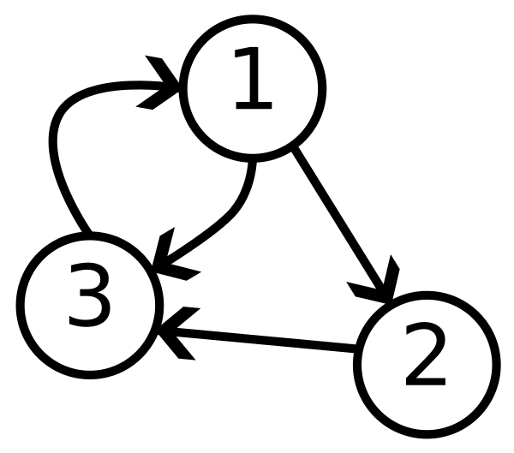
Graph (2/3)
There are two special extra vertexes: the source and the sink
The graph works like this (over-simplified):

Slide 11
Graph (3/3)
A couple of alterations were made to the graph:
The Parser creates the Vertex and addVertex() receives a pointer to the Vertex;
findEdge() and removeEdge() now receive pointers to the vertexes instead of their id’s

Slide 12
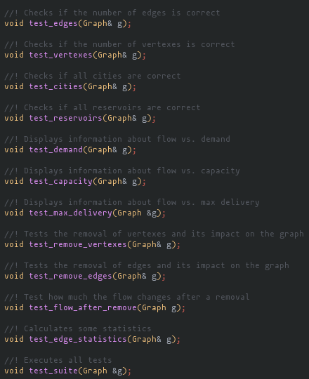
Tests
Checks graph integrity and correctness
Some change the graph, some don’t
Displays useful information about the whole water network

Slide 13
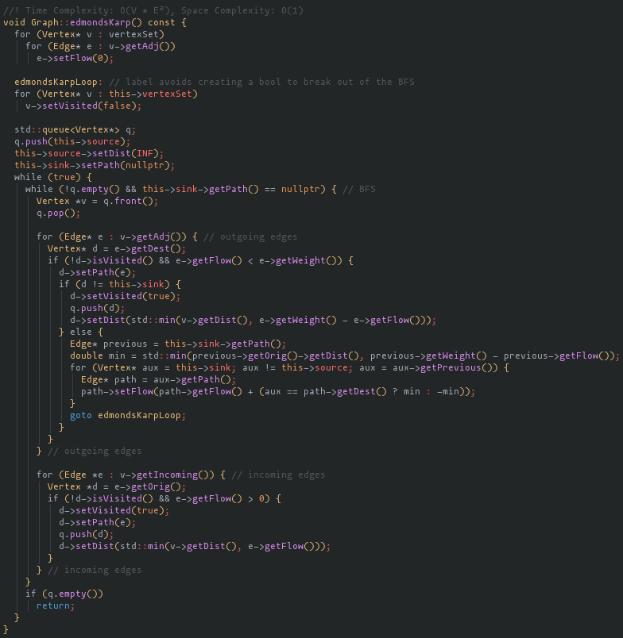
Edmonds-Karp
Uses BFS to compute paths
Avoids double search after computing path by storing maximum flow until each Vertex from the source
Fixes negative flow after completion
Uses a label and a goto statement to avoid creating a bool to break out of the loop
Time Complexity: O(V * E²)

Slide 14
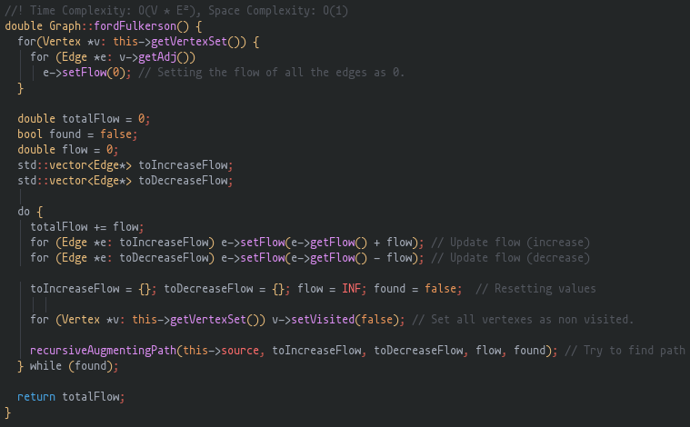
Ford-Fulkerson (1/2)
Uses DFS to compute paths
Has the same complexity as the Edmonds-Karp algorithm
Uses an auxiliary recursive function

Slide 15
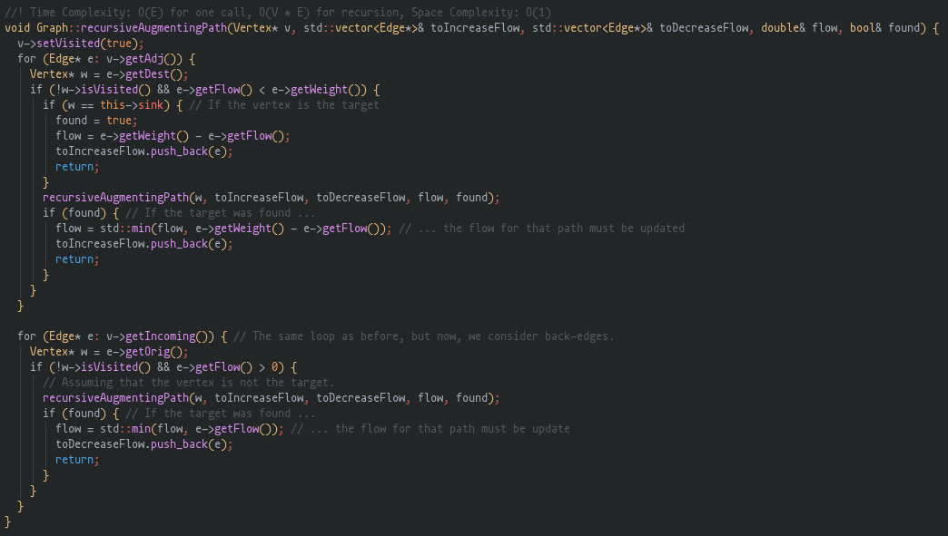
Ford-Fulkerson (2/2)
Auxiliary function for Ford-Fulkerson
For each Vertex, searchs the outgoing and incoming edges
The max flow obtained is equal to the Edmond-Karps one
Time Complexity: O(V * E²)

Slide 16
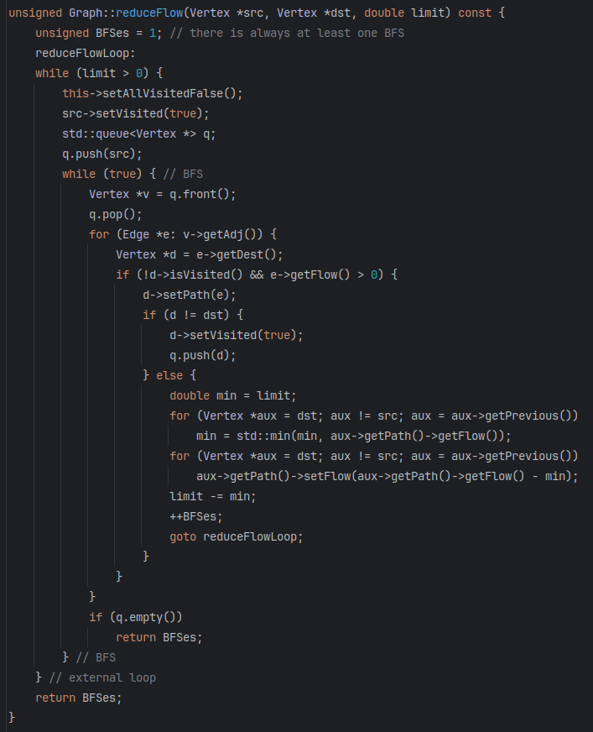
Reduce Flow
Reduces the flow from a vertex to another by an amount smaller or equal to the value provided
Based in Edmonds Karp algorithm, buts decreases the flow instead
Time Complexity: O(V * E²) in the worst case
Although the complexity is the same as in Edmonds Karp algorithm, this one is more efficient, because it doesn’t have to go through all the augmenting paths

Slide 17
Removal of Vertex and Removal of Edge
Before removing a Vertex, the algorithm to reduce the flow (as discussed in the previous slide) is executed from the Super Source to the Vertex to be removed and then again from it to the Super Sink.
Following the same principle, before removing an Edge, the algorithm to reduce the flow is executed from the Super Source to the origin of the Edge and then again from the destination of the Super Sink
After removing a Vertex or an Edge, we add them to a vector of removed Vertexes and Edges in the Graph to allow the user to easily restore them

Slide 18
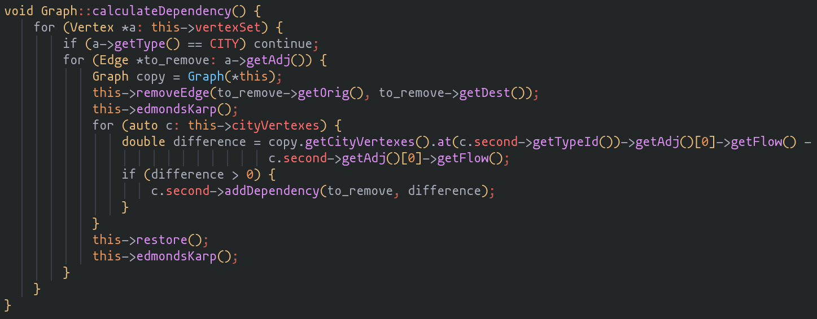
Calculate Dependencies (1/2)

Slide 19
Calculate Dependencies (2/2)
This algorithm calculates changes in flow and unfulfilled cities demand after the removal of every actual edge in the graph (one at a time, restoring after calculations)
The edges SOURCE - cities and cities - SINK are ignored
It also marks the edge as essential to the city (in other way, the city dependent on the edge) if the flow through the city decreases after its removal
Time Complexity: O(V * E³), Space Complexity: O(1)
This algorithm is executed in the beginning of the program

Slide 20
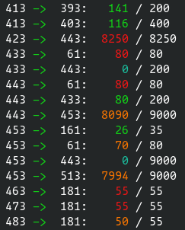
Flow vs. Capacity
(extract of output)
test_capacity()
Cyan - not used (0 flow)
Green - 0% < usage ≤ 85%
Orange - 85% < usage < 100%
Red - Completely used

Slide 21
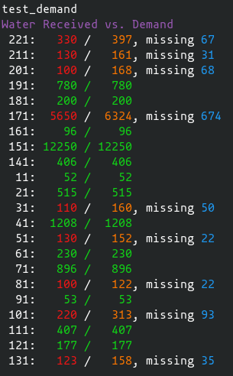
Flow vs. Demand
Obtained with test_demand()
The white numbers are the IDs of the cities
When parsing, the actual IDs are multiplied by 10 and added 1
Some cities had their demand fulfilled, while other didn’t

Slide 22
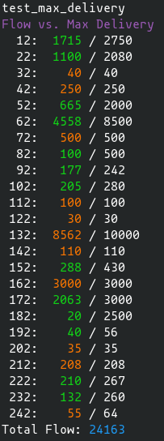
Flow vs. Max Delivery
Obtained with test_max_delivery()
Green - 0% <= usage <= 85%
Orange - 85% <= usage <= 100%
All of them are used
Some of them have really low usages (like 182 - 0.8%)

Slide 23
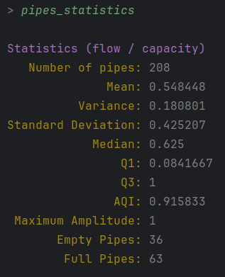
Statistics
Obtained with command pipes_statistics
As the edges/pipes have very different capacities, the ratio was used instead
At least 25% of them are being fully used

Slide 24
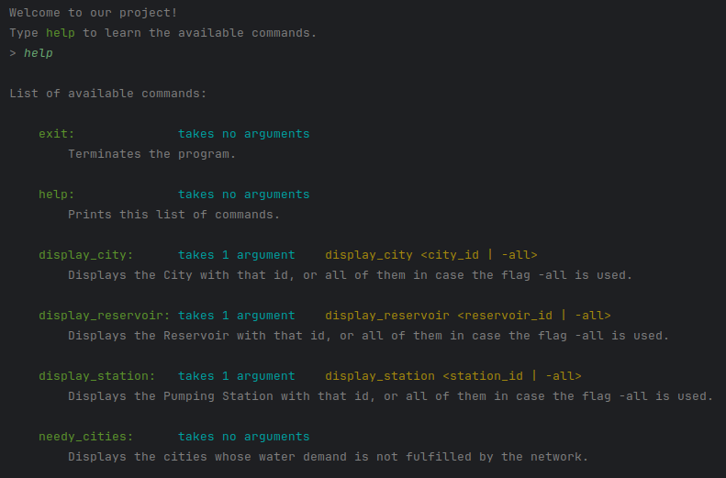
User Interface (1/3)

Slide 25
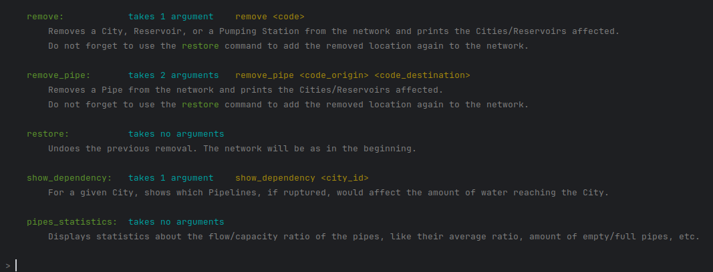
User Interface (2/3)

Slide 26
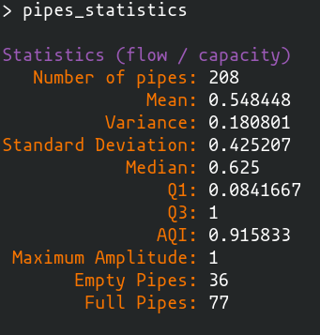
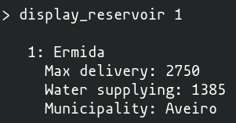
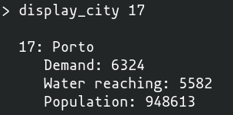
User Interface (3/3)

Slide 27
Problems
1. After Edmonds-Karp, some pipes were left with negative flow and some were overused
2. How to Balance Edges

Slide 28
Solutions (1/2)
1. This was rather quickly fixed - it was due to an external loop and return condition deemed unnecessary, which would not alter the max-flow but would fix negative flows and overusage

Slide 29
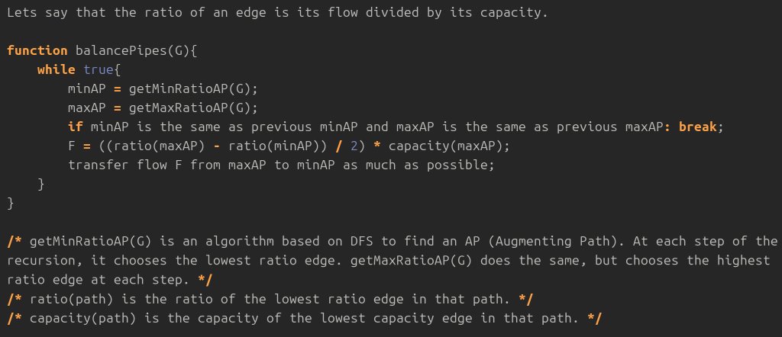
Solutions (2/2)
2.

Slide 30
Bibliography
Slide 3:https://upload.wikimedia.org/wikipedia/commons/1/15/3_node_Directed_graph.png?20230623211051
Font used (by Nerd Fonts, clicking here will download the font): https://github.com/ryanoasis/nerd-fonts/releases/download/v3.1.1/Hack.zip
All other images and descriptions were made by us

